Slide 1

Intro to VR – Minigame
By: Jeremy Nielson

Slide 2
Minigame HUD
Starting out, we will need a HUD to give the player information as the game progresses. We are going to start by adding a timer on the screen so the player can see how much time is left.
The following screen will show you the sizing you will use for this specific game. Try your best to model what I have here, but your placement of objects may vary so adjust the settings as needed.
We will need a canvas, Timer, Time, ScoreLabel, and Points. Please name these text fields accordingly.
This canvas will be attached to the Player under Player > Follow Head
This will make sure it tracks with the players view so it is visible.

Slide 3
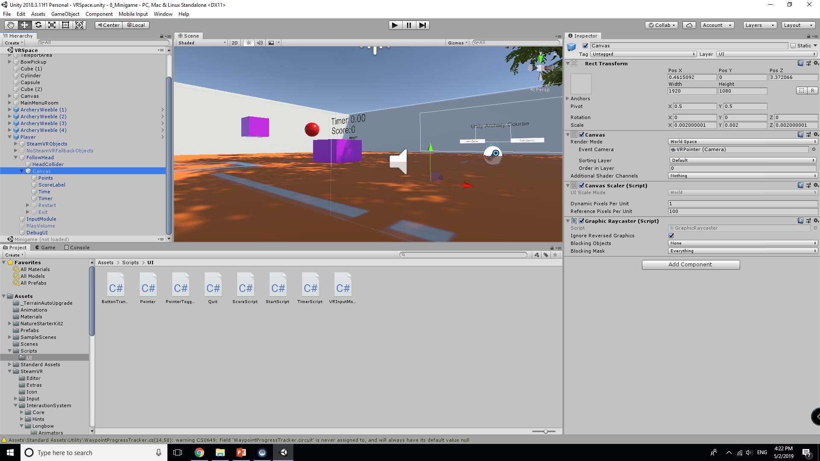
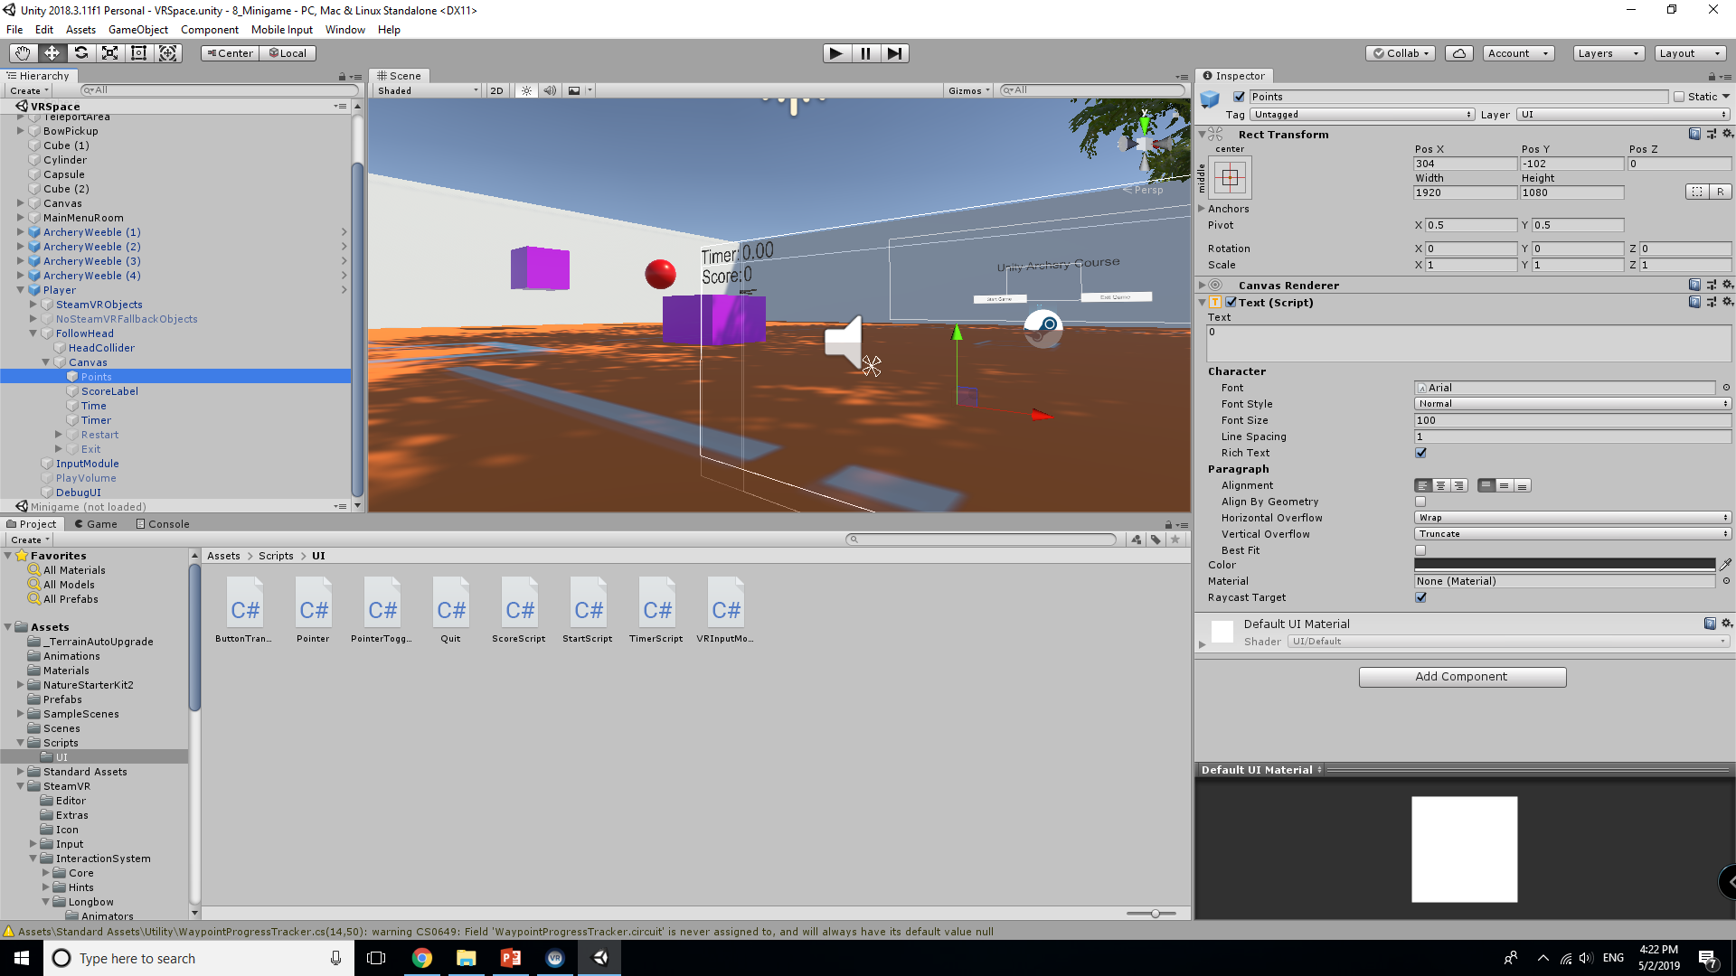


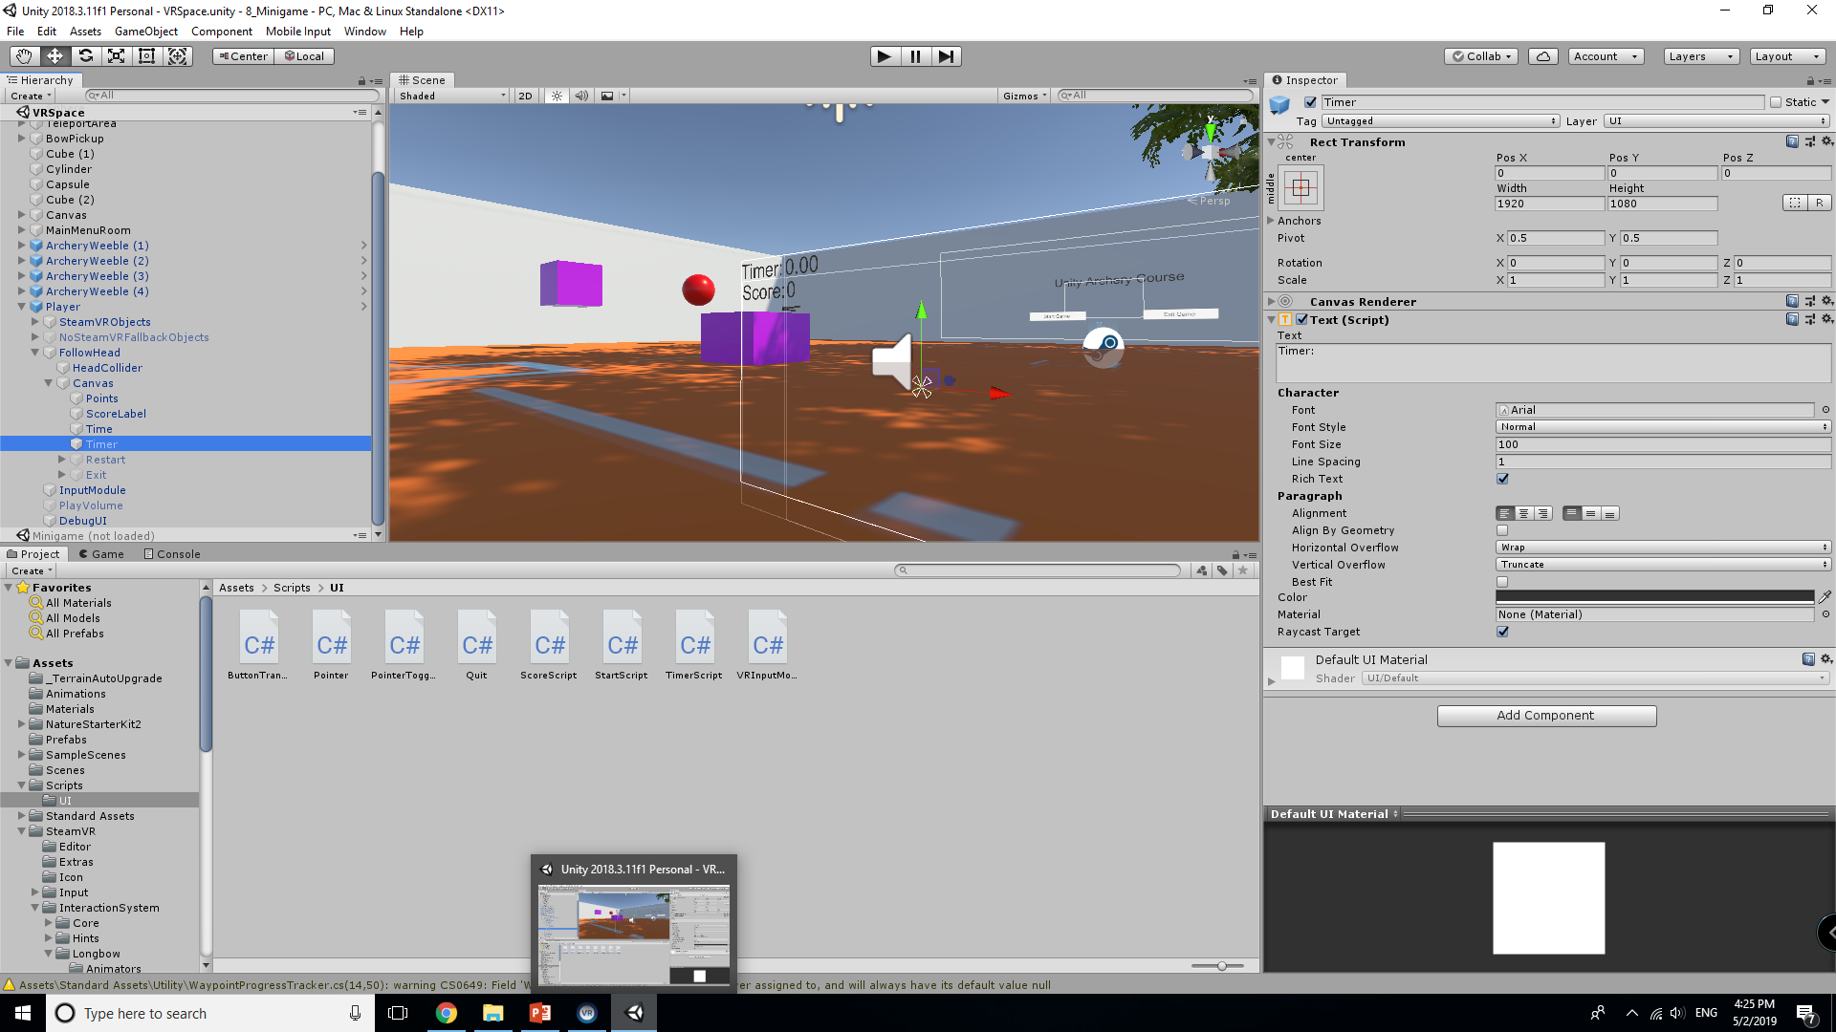

Slide 4
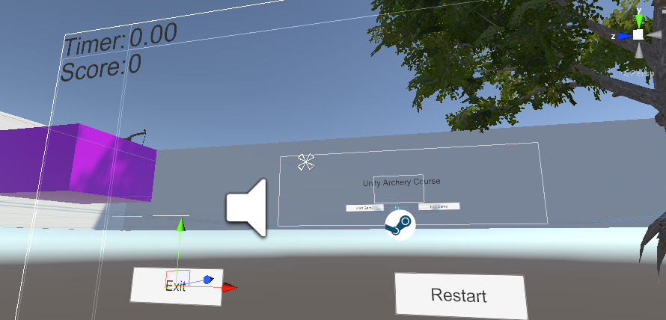
Adding Buttons to the HUD
Additionally, Create two buttons on the lower portion of the canvas. One for Exiting, One for Restarting.
It is good practice to always have your exit buttons on the same side of the screen across all interfaces as to not confuse the player.
Put the Exit button on the left and the restart on the right, Set them as inactive

Slide 5
Timer Script
The script we will develop will need to count down from 90 seconds. This will be triggered the moment the player picks the bow up and the game will end at the end of the timer.
At the end, the pointer is enabled, the score/timer will lock, and the player may restart the game or quit.
If the game is reset, the variables are reset and the timer will begin counting down immediately afterwards.

Slide 6
Object References and Multi-Scenes
These scripts will need access to objects that are not available in a single scene at any given time, so we need to pass Runtime references to objects.
Unity does not support the use of object references across scenes, so any scripting you do that requires objects from another scene will need to be handled via Scene Management and Runtime references.
Since we have a fairly simple game with two scenes, we will be just taking care of object references in these scripts.
You will see the full paths to certain objects in the following script. These paths are where the objects exist at run time.

Slide 7
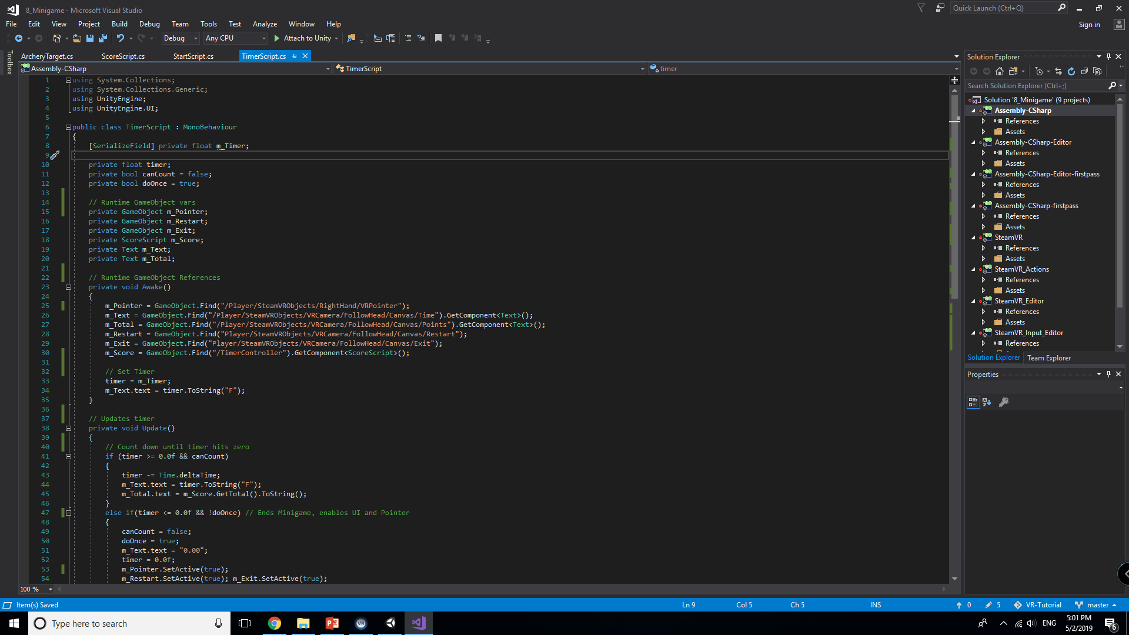
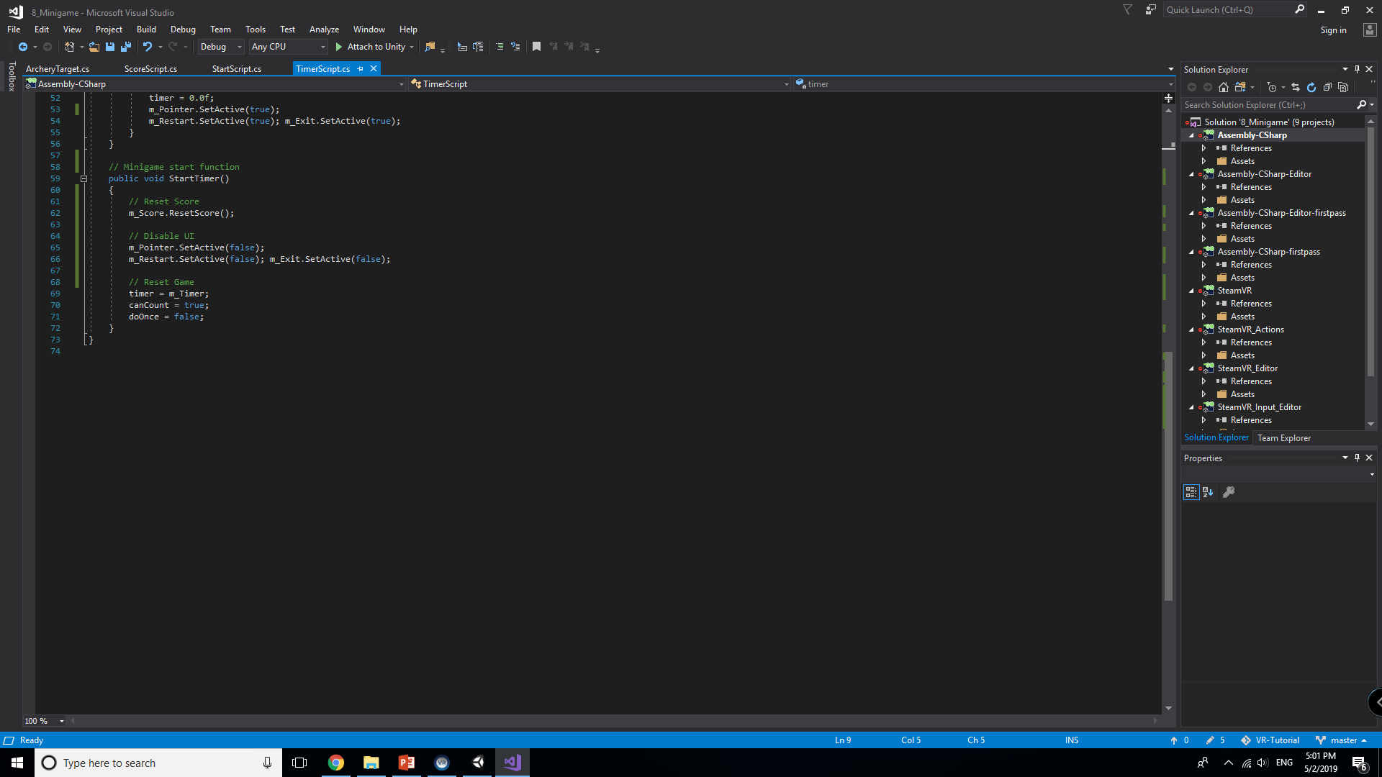

Slide 8
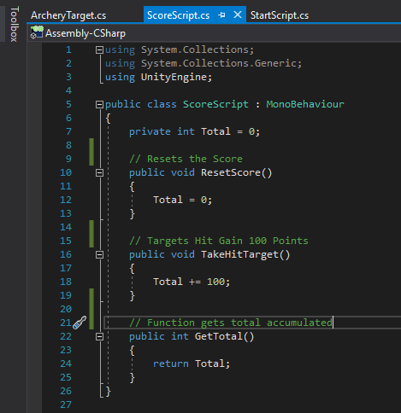
ScoreScript
The next script will be fairly simple. We need a way to keep score for the game.
We already included m_Score in the TimerScript, so we need to implement its functionality.
There are three basic functions that are self-explanatory.

Slide 9
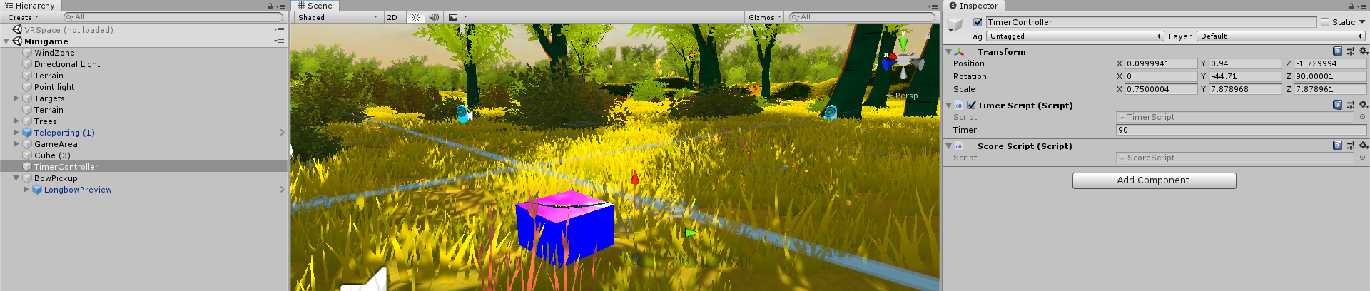
TimerController Object
This Object will exist inside of the Minigame. It is an empty GameObject that will act as an event handler / interface for the minigame components to interact with each other.
All that is needed is for it to be created and then attach both of the previous scripts to the object.

Slide 10
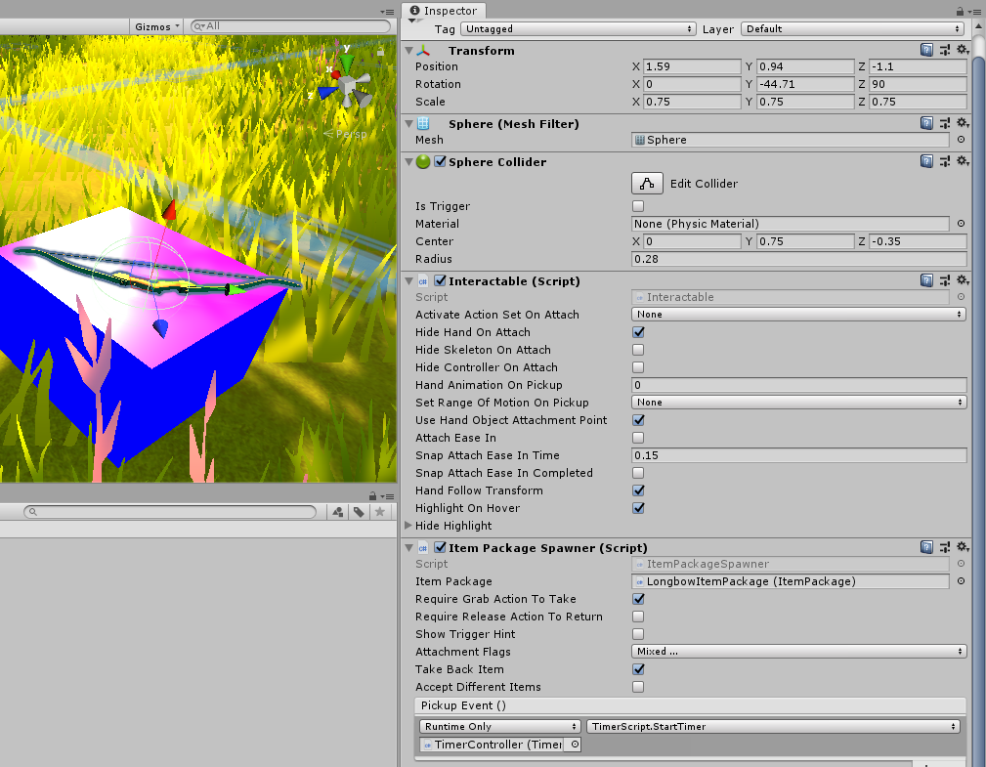
Minigame Start
We will need to make sure that when the bow is picked up, the minigame starts.
Luckily, the bow already has an event system for this.
We will just need to attach the TimerController and the TimerScript.StartTimer Method.

Slide 11
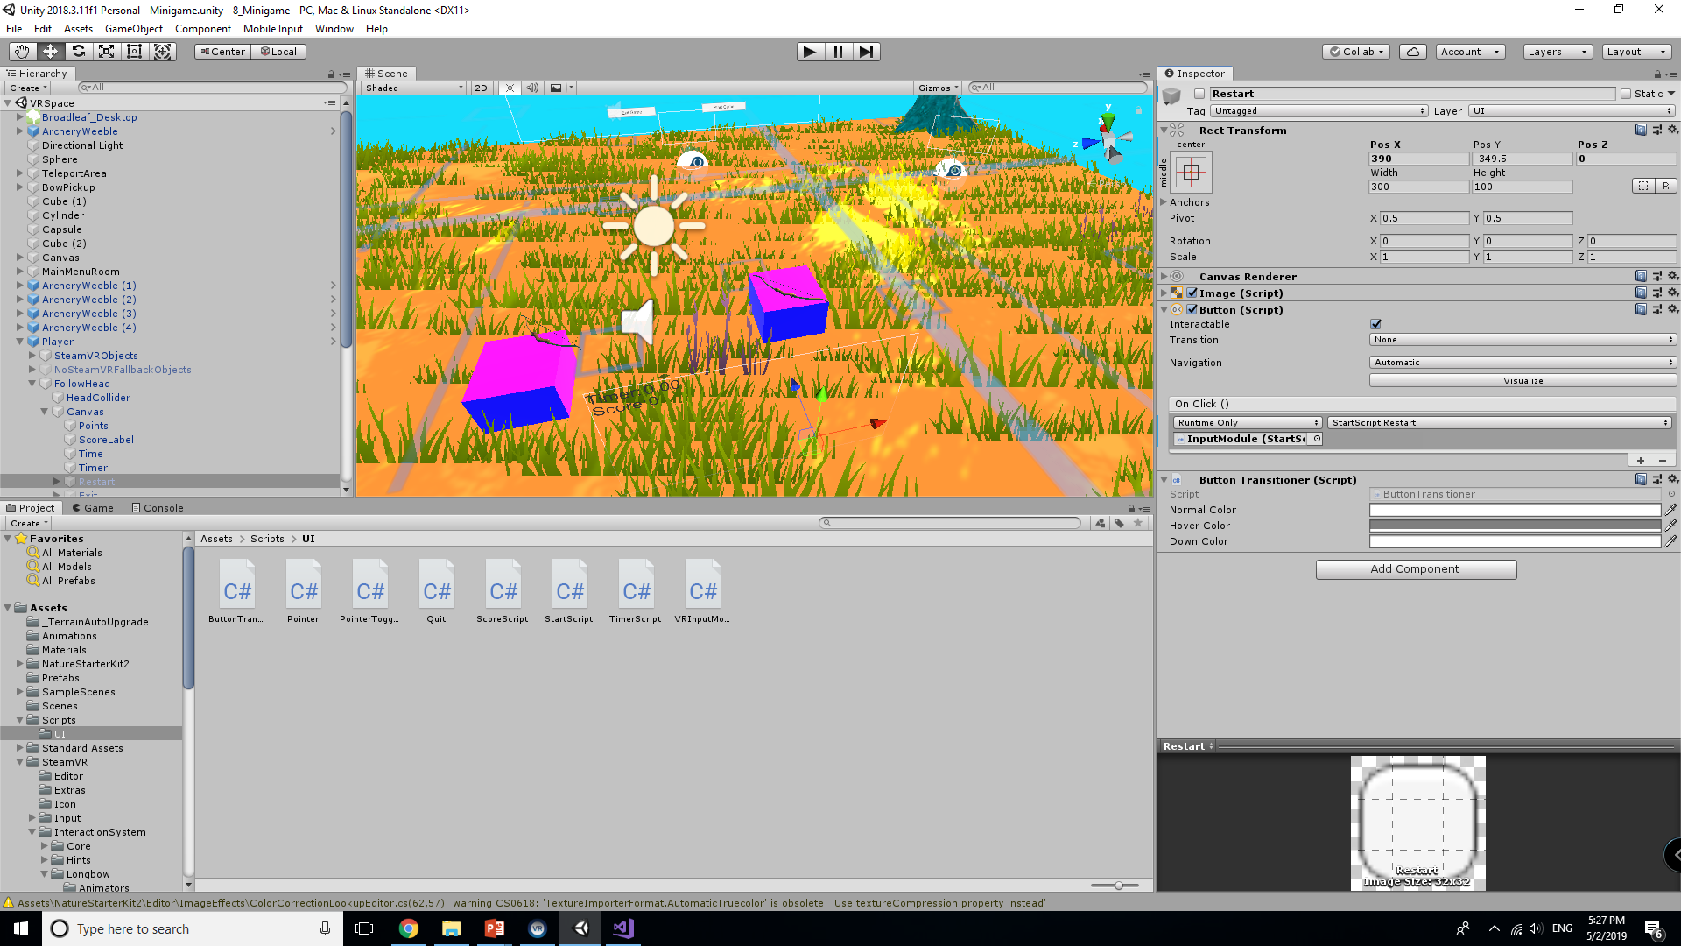

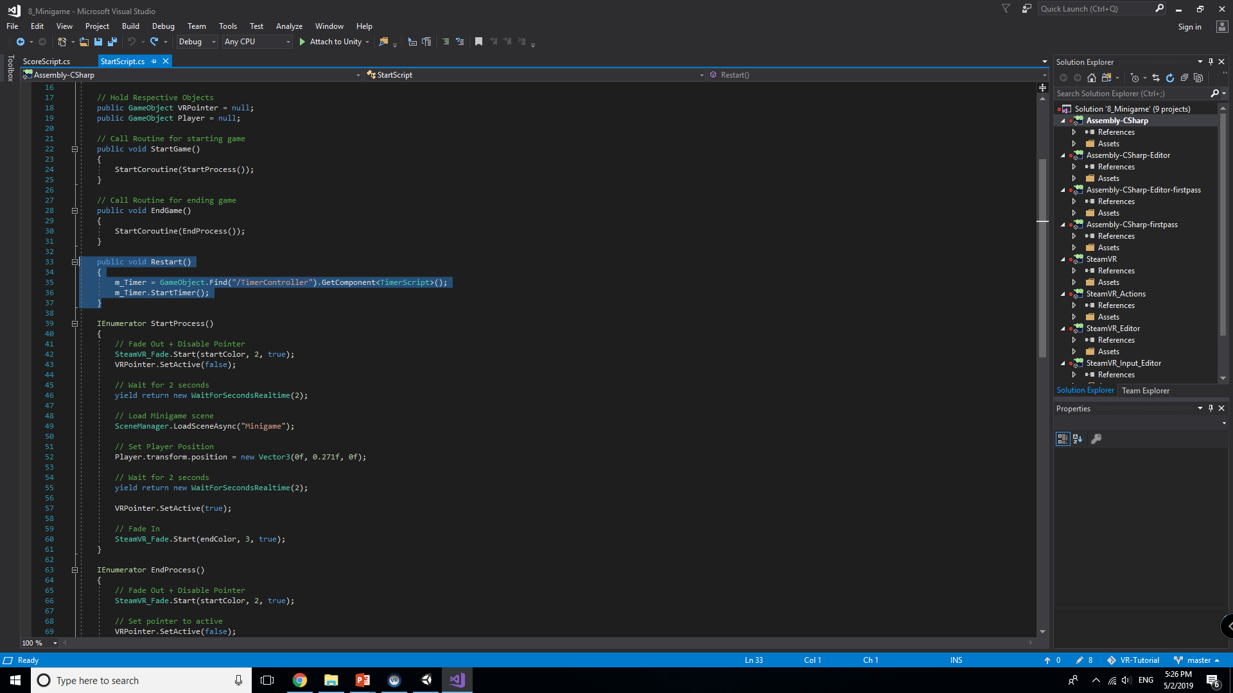
Minigame HUD Events
We also need to make sure the HUD Elements have their respective events.
Quit should quit the application as expected, and the restart button should just reset the timer and score.
We created a Reset Function in the previous tutorial under StartScript. We will be using that here.

Slide 12
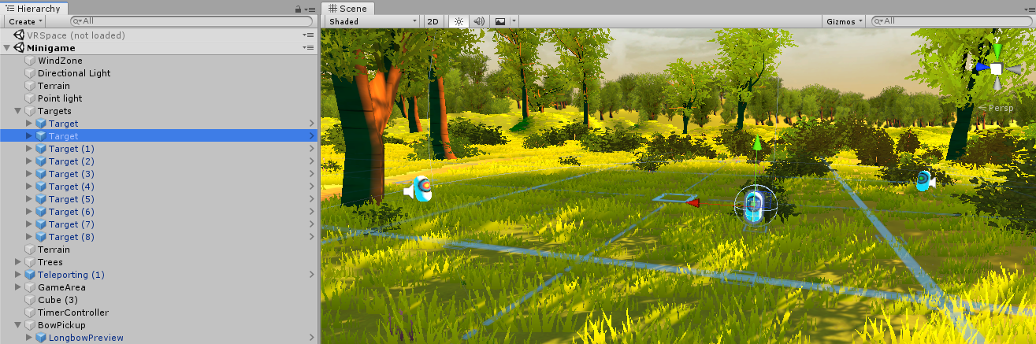
Minigame Targets
We will need something for the Player to shoot at and build score. We will be using the same targets from before that spawn balloons on hit.
For better organization, create an empty GameObject called targets, and place a few ArcheryWeeble objects on the map. They are once again found under Archery in the SteamVR Assets. You can also search to find them.

Slide 13
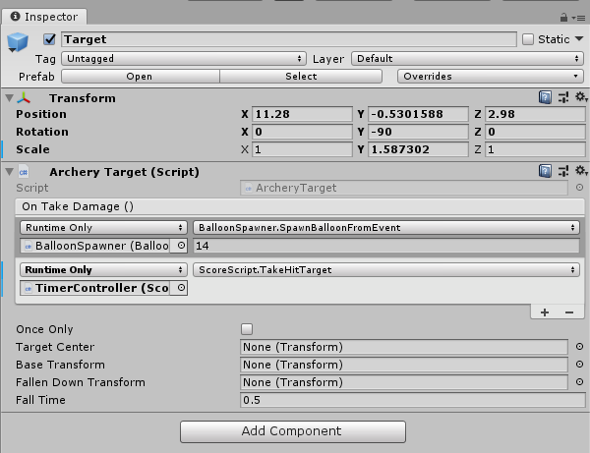
Target Hit Score
The targets must also add score to the total earned from the minigame.
The Archery Targets already have a function called On Take Damage() where in inspector we can provide additional script events to happen.
Attach the TimeController object and use the ScoreScript.TakeHitTarget() function.
Make sure to do this for each target placed.

Slide 14
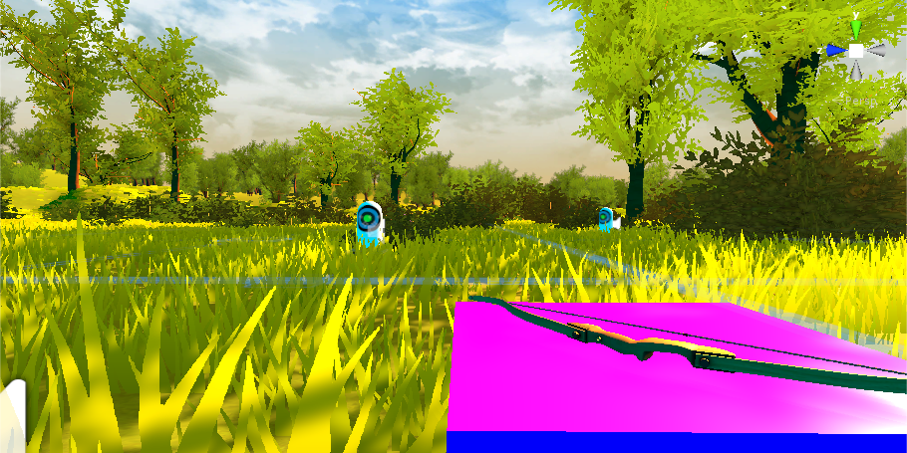
End Result
You now should be able to when hopping into the game:
Use the main spawn room to test the mechanics
Select whether to Quit or Start Game with the pointer
Transition to the new scene
Play the minigame with a timer and score system
Restart the game or quit after

Slide 15
Where from here?
While these tutorials cover the general basics of VR Development, Unity, and SteamVR, there is a lot more potential and material not covered here specifically.
Scene Management is necessary when dealing with multiple scenes the player can go to and from. Having an additional always loaded scene to maintain objects that transition between scenes will help.
SceneManagement Docs
Physics-based interactions are common for VR Games and are worth checking out.
Create Throwable Objects
Look Into the SteamVR Plugin Assets and Documentation for more functionality
SteamVR API Documentation

Slide 16
More Resources
Get involved with the Unity community if you have more specific questions for development.
Unity Forums
There are also a ton of assets available on the web or in the Unity Asset Store regarding VR. I highly recommend with development using SteamVR as a basis since it supports the most devices.
IF you intend to use Oculus, it is worth noting that if you plan to make a game for the Oculus Store, you MUST HAVE A BUILD THAT DOES NOT HAVE OpenVR WHATSOEVER. Oculus will not allow you to sell on their platform unless it is an Oculus specific build of the game.
I highly recommend you continue working with VR Development. The realm is always changing and adapting to new technologies, and with new headsets and controllers on the horizon there is leaps and bounds to be taken.

